Slide 1

Efficient Frequency Response Analysis block for Qspice - Rev.3
By: Arief Noor Rahman

Slide 2
Background
In Qspice currently there are two approach for FRA, however they both have their own advantage and disadvantage.
To use “.bode” directive
+ Very fast analysis
- The algorithm is not published
- Not the best accuracy (from Mike’s word)
- Performed in post processing
To use “.meas fra” directive
+ Utilize standard fourier series algorithm implementation
+ Considered to be the go to reference for standard fra implentation
- Performed in post processing -> large transient data storage is required and also rather slow

Slide 3
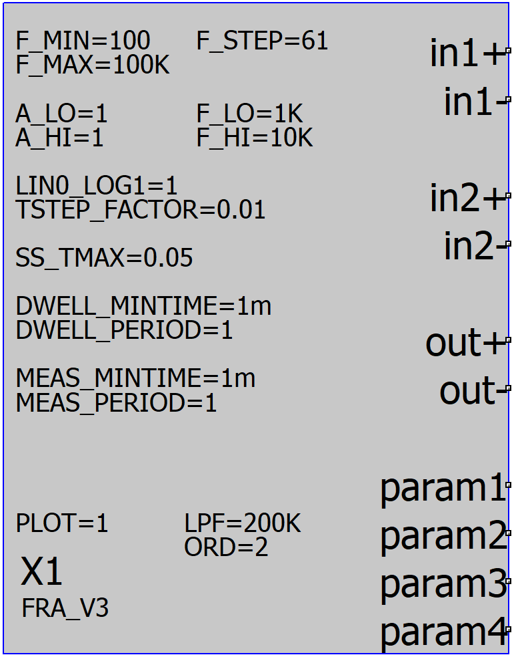
The FRA block - Introduction
The main motivation to develop this FRA block that runs fast, accurate, and storage efficient (does not require .qraw). Additionally, this FRA block has parameters that is equal to the actual physical FRA analyzer.
Features:
programmable magnitude signal injection
programmable linear or logarithmic scale injection frequency stepping
programmable startup pre-dwell time
programmable injection dwelling time/period
programmable measurement dwelling time/period
users can easily observe if the time domain data is good enough and made necessary alteration on the FRA block parameters to improve the result
Provide param1~4 input to let user save the circuit operation point at the end of pre_dwell period

Slide 4
The FRA block - Under the hood (1)
The core of the FRA block is by simply applying injection signal and analyze the measured input and output signal using fourier series.
Fourier series is implemented using behavioral source and integral command idt(), as analog integrator implementation will be a lot more accurate compared to the C-block implementation.
By running the integral command in real time instead of as a post-processing as in the alternative method, our approach is able to run reasonably fast and reliable. *storing transient data into .qraw takes a lot of time
A C-block is used to control the signal injector (amplitude, frequency, and duration) at different time of the simulation and to sample the integral result to obtain the fourier spectrum.

Slide 5
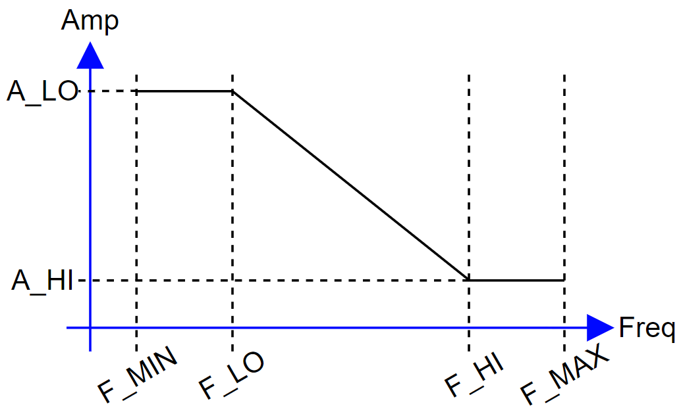
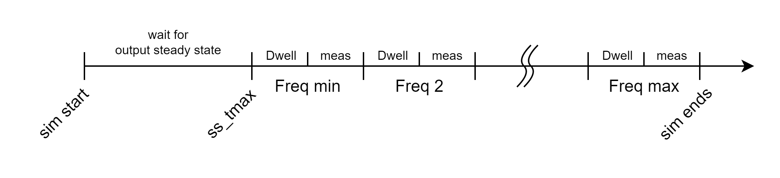
The FRA block - Under the hood (2)
Custom user-defined injection amplitude-frequency relationship to maximize the analysis accuracy
Timing arrangement during the transient simulation from beginning to the end

Slide 6
The FRA block - Under the hood (3)
To ensure measurement accuracy three dwell times are use in this custom FRA block.
SS_TMAX time
This parameter is used to let the FRA block to wait for a certain duration until the circuit can certainly reach steady-state without any disturbance injection. Pre-dwell time only occured one for the whole duration of transient simulation.
DWELL_MINTIME and DWELL_PERIOD
These parameter is used to let the circuit reach the next bounded AC steady-state with various AC disturbance injection. The C-block will choose the one with the longest duration for any given frequency.
MEAS_MINTIME and MEAS_PERIOD
These parameter is used by the c-block to determine the sampling duration of the fourier series spectrum. The C-block will choose the one with the longest duration for any given frequency.

Slide 7
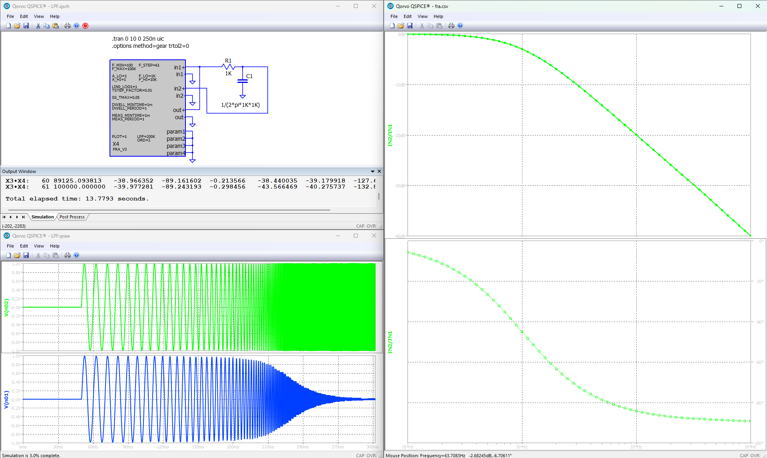
Basic Example

Slide 8
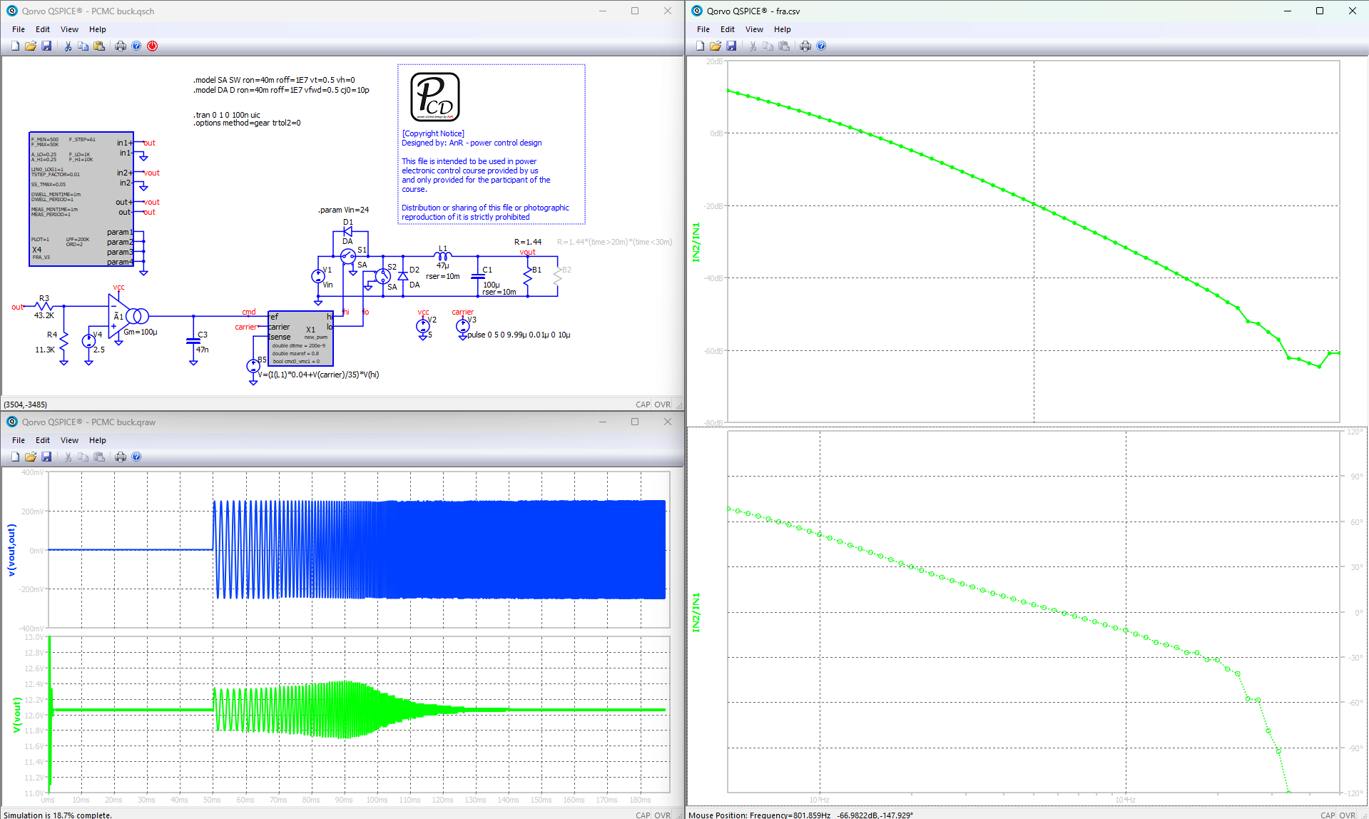
DUT Converter Example Data Output

Slide 9
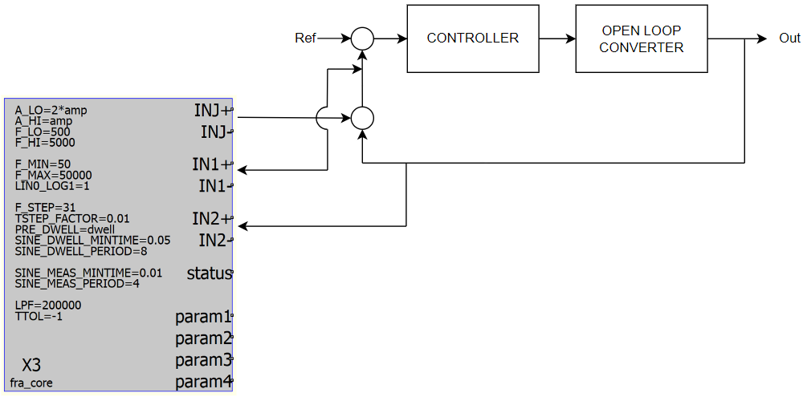
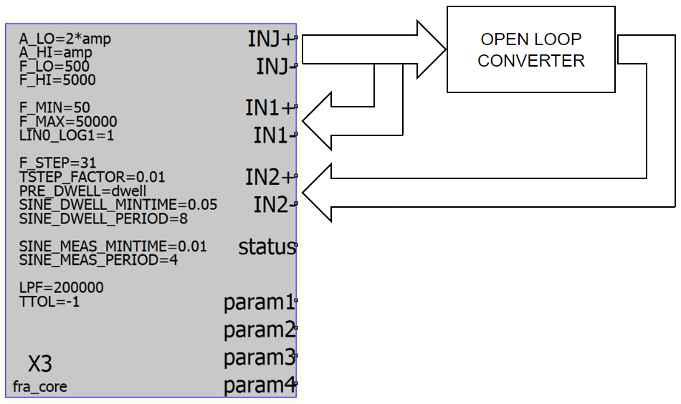
Possible Connection for Converter Analysis
Open Loop Gain Analysis
Close Loop Gain Analysis
This picture is taken from the old reference guide, the injection signal name has been changed from “INJ” to “OUT”.
Nevertheless the wiring method remain the same.

